Slide 1

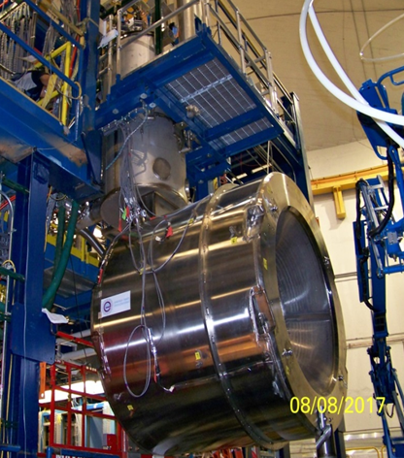

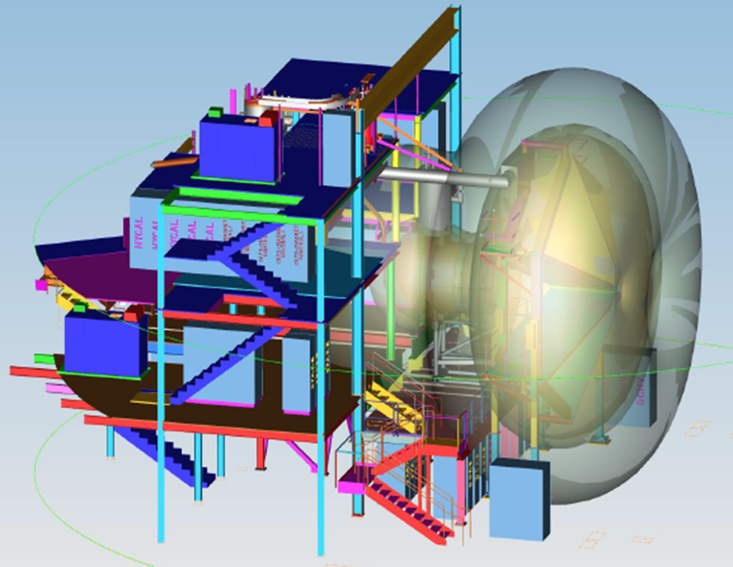
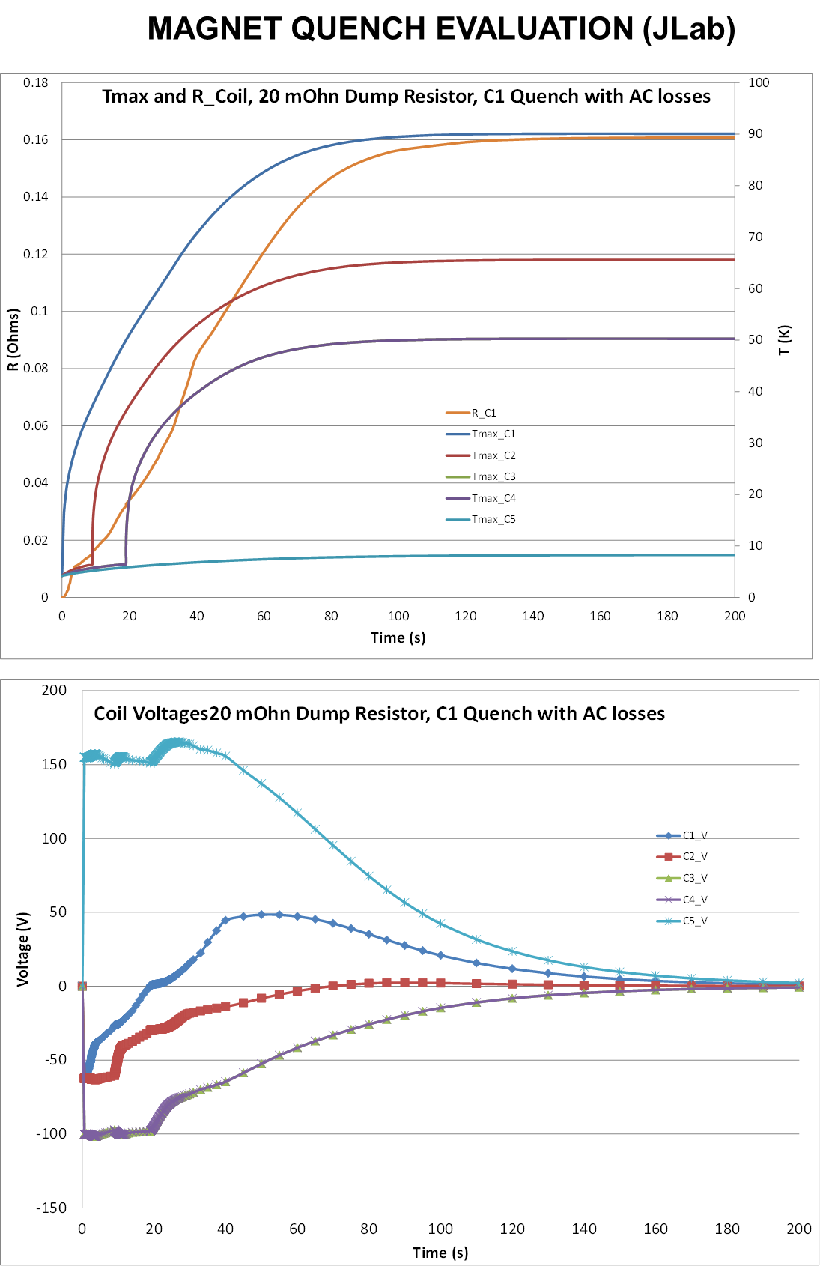
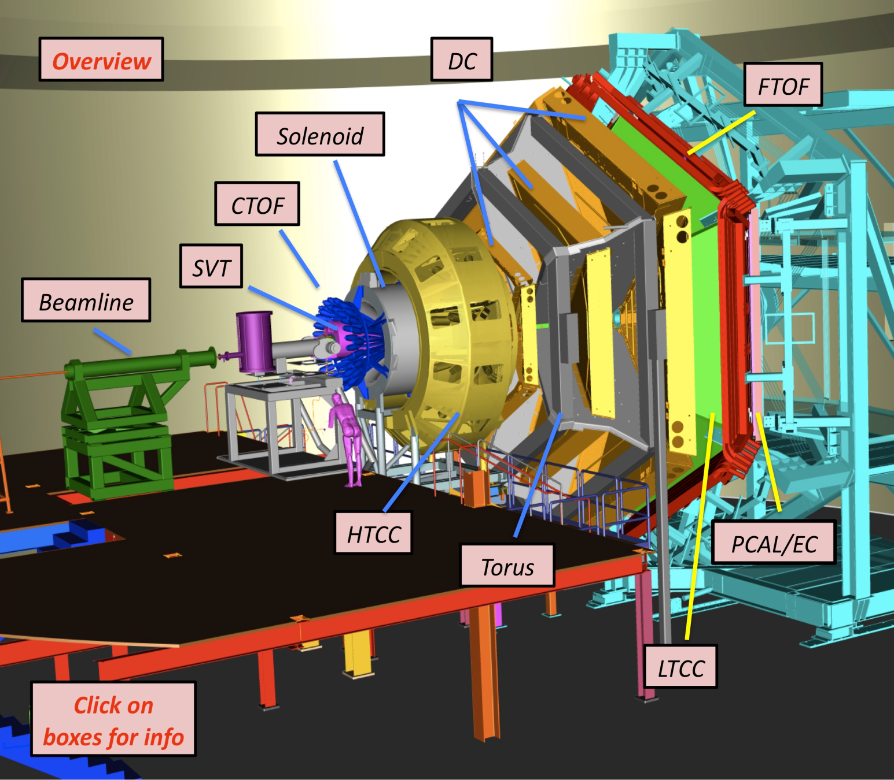
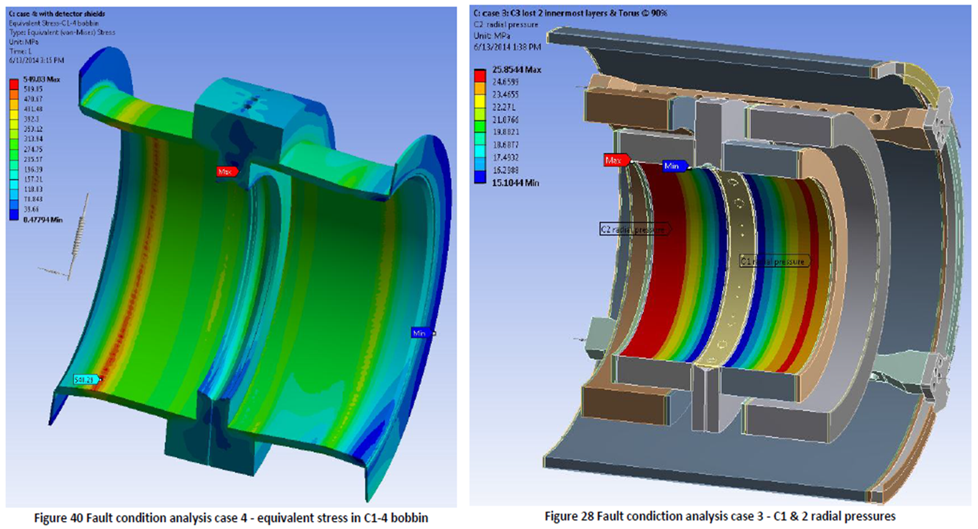
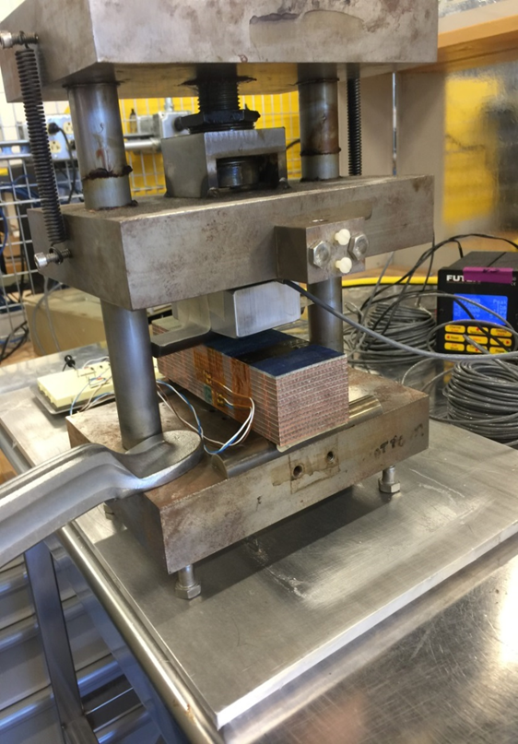
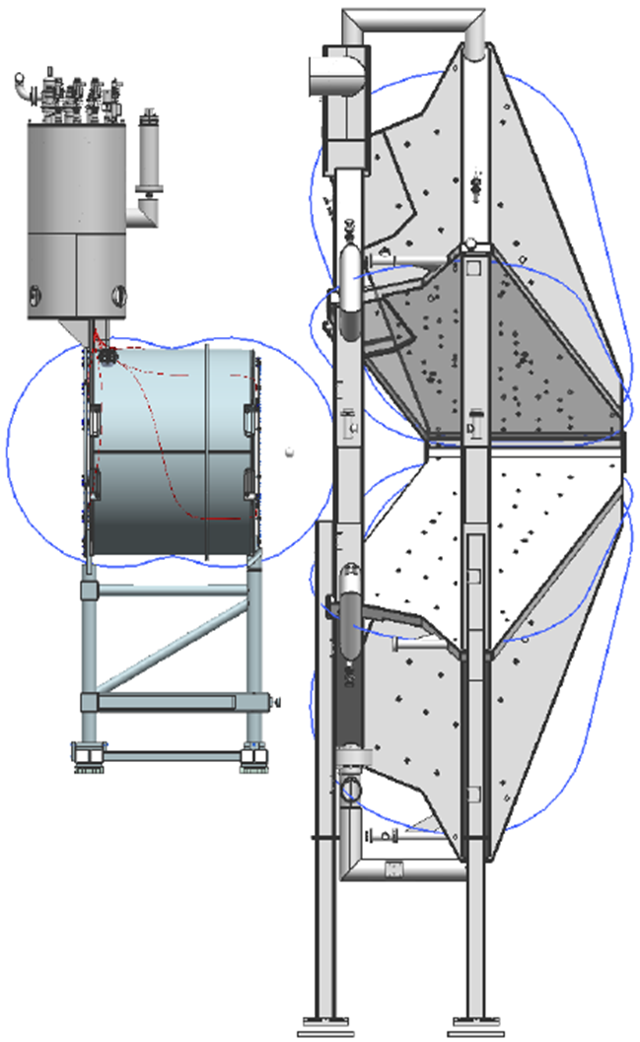
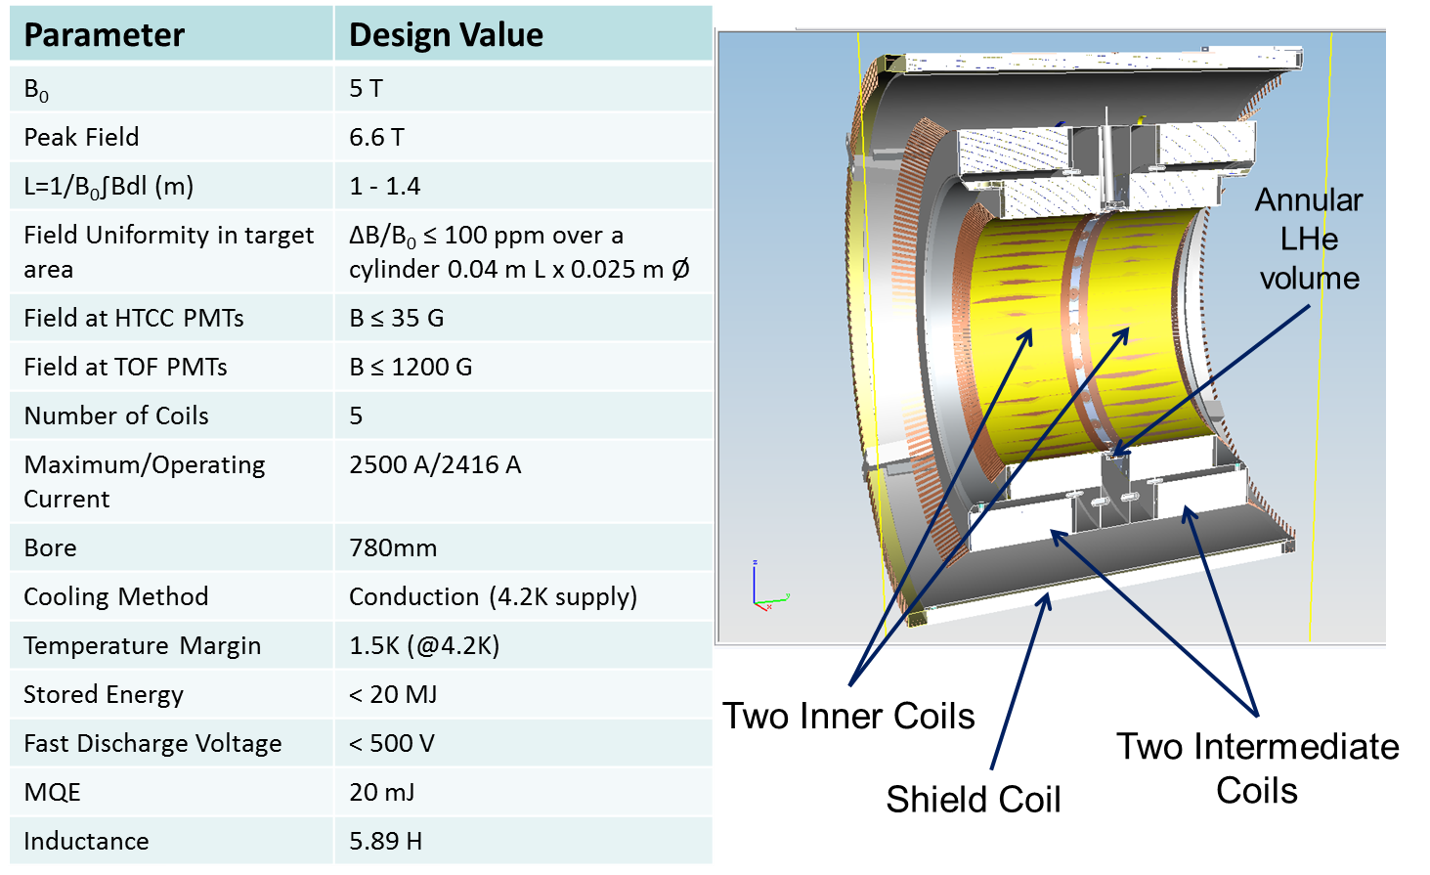
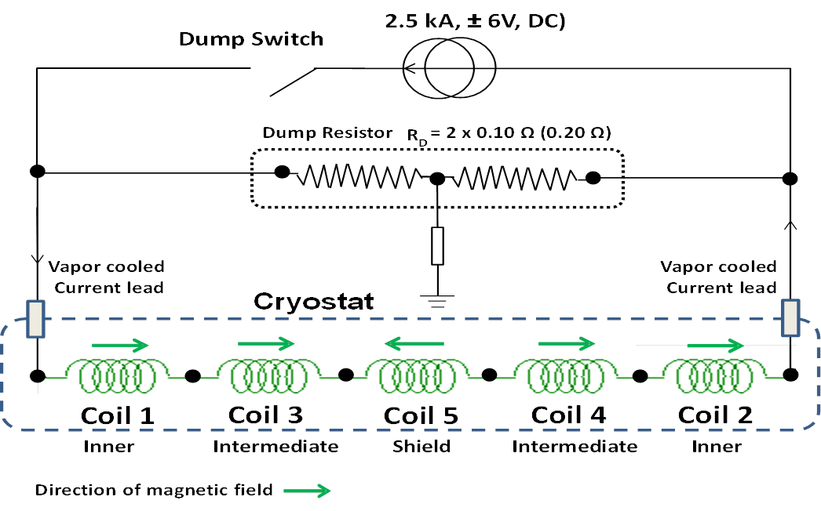
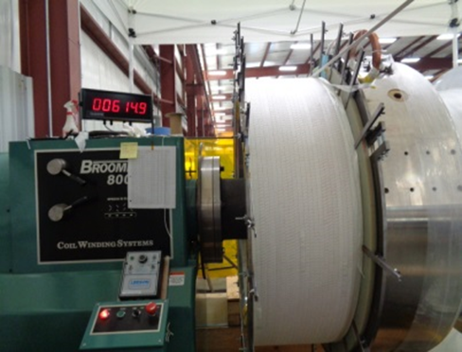
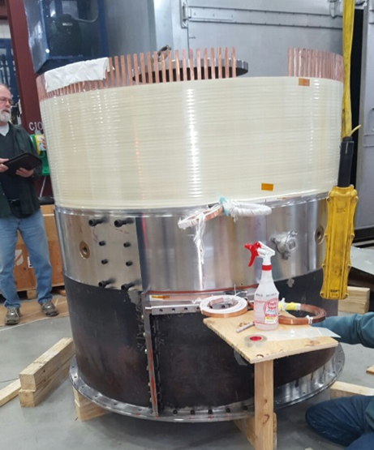
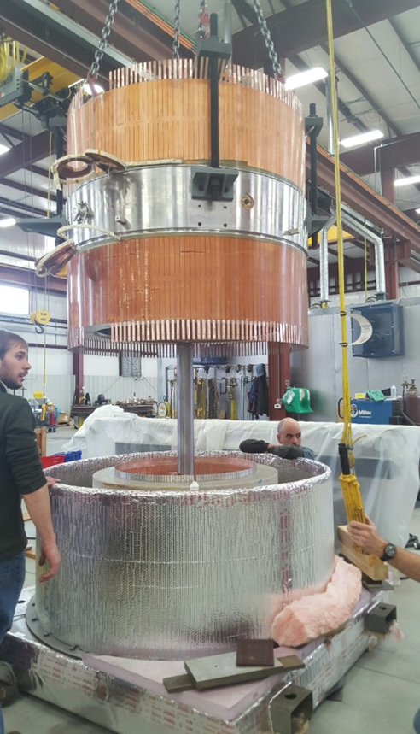
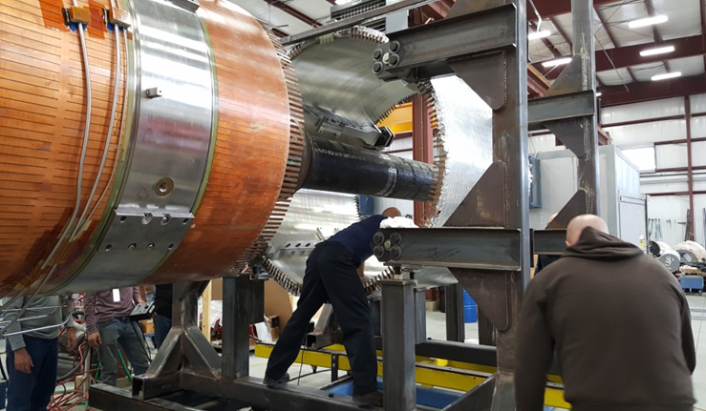
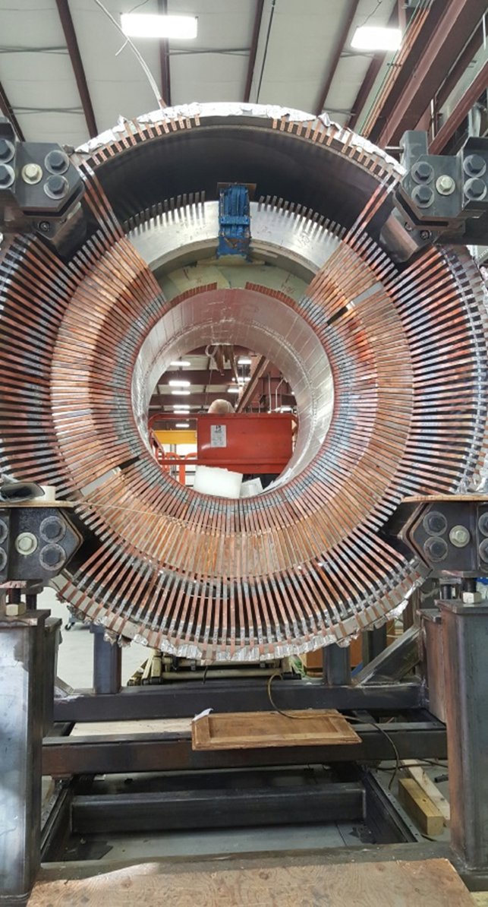
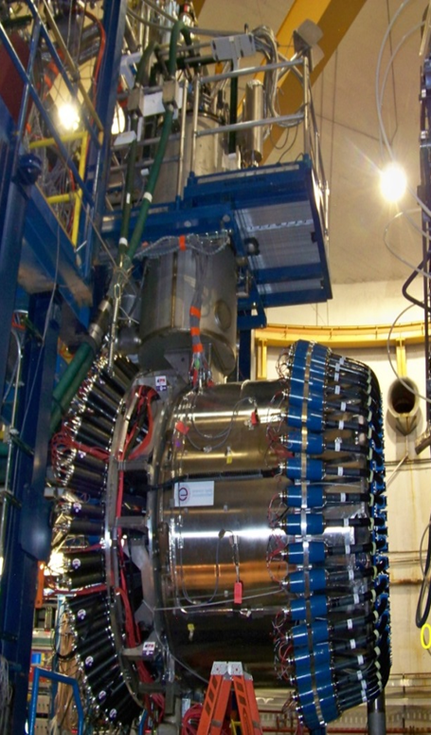
Solenoid
Superconducting Magnet
Thomas Jefferson National Accelerator Facility
What is it?
Designing the Solenoid Magnet
The Solenoid Superconducting Magnet is used to:
Bend the particle trajectories so the detectors can measure their momentum
Provide Magnetic Shielding against background from the beam
The charged particles produced by nuclear reactions between the beam and the target are steered by the Solenoid magnetic field so that they can be detected by the different physics detectors.
The high intensity beam produces a background halo that the solenoid shields: w/o its magnetic protection, carrying out experiments would be impossible.
Left: The Solenoid magnet has 5 superconducting coils located within a vacuum jacket. The coils are cooled to
-268ºC (-450ºF). The vacuum jacket is like a thermos flask but in this case helps to keep the coils cold rather than hot.
Below: The Solenoid magnet surrounded by physics detectors
Tech Specs
Superconducting wire (Niobium Titanium or NbTi)
Some design calculations and tests. Top left: Magnetic field produced by the solenoid Top Right: Calculation of coil resistances, voltages and temperatures during a quench. Middle Left: Design of the superconducting coils. Bottom Left: Testing the mechanical strength of a stack of superconductors. Bottom Middle: Electrical circuit for the Solenoid Bottom Right : Checking to see how the magnetic fields from the Torus and the Solenoid interact with each other.
Building and Installing the Solenoid
Did you know?
The freezer in your refrigerator at home keeps your ice-cream cold at -18ºC (about 0ºF). The Solenoid superconducting coils are kept cold at -268ºC (-450ºF) – nearly as cold as outer space! We use liquid Helium to do that!
Helium gas was first discovered on August 18th 1868 during a total solar eclipse of the sun. A scientist managed to liquefy it on July 10th 1908 – yes….the same scientist who discovered superconductivity, Kamerlingh Onnes. That was on a Friday, in case you were wondering.
The Solenoid magnet was designed in a little town on the South coast of England, built in the heart of coal country in Pennsylvania and is now installed in the greatest state of the nation, Virginia – the birthplace of America!
When the Solenoid is fully powered up, it has as much energy as 11 Toyota SUVs traveling at 75 MPH on the highway or 8 pounds of TNT! Yes….even more energy than that Torus magnet next to it.
Niobium Titanium is the superconductor used in the Solenoid coils. The metal Niobium is presently only mined in two places on Earth – Brazil and Canada.
The magnetic field produced by the Solenoid magnet is more than 100000 times stronger that the Earth’s magnetic field!
The central bore of the Solenoid is large enough for you to crawl into it…….don’t do it though!
YOU ARE STANDING NEXT TO A UNIQUE SUPERCONDUCTING MAGNET! Go on… take a selfie with the CLAS12 Solenoid and tell the world!
Superconducting coils being wound at Everson-Tesla Inc, Nazareth, PA
Superconducting coils being prepared for potting with epoxy resin
Superconducting coils being fitted together using liquid Nitrogen
Contributing Institutions
Jefferson Lab, Newport News, VA, USA
Everson-Tesla Inc, Nazareth, PA, USA
Tesla Engineering, England, UK
Inserting the finished superconducting coils into their vacuum jacket
Installing the Copper cooling fingers which are used to cool the coils to liquid Helium temperatures
Installing physics detectors in and around the solenoid at JLab

